Slide 1
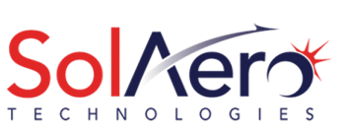
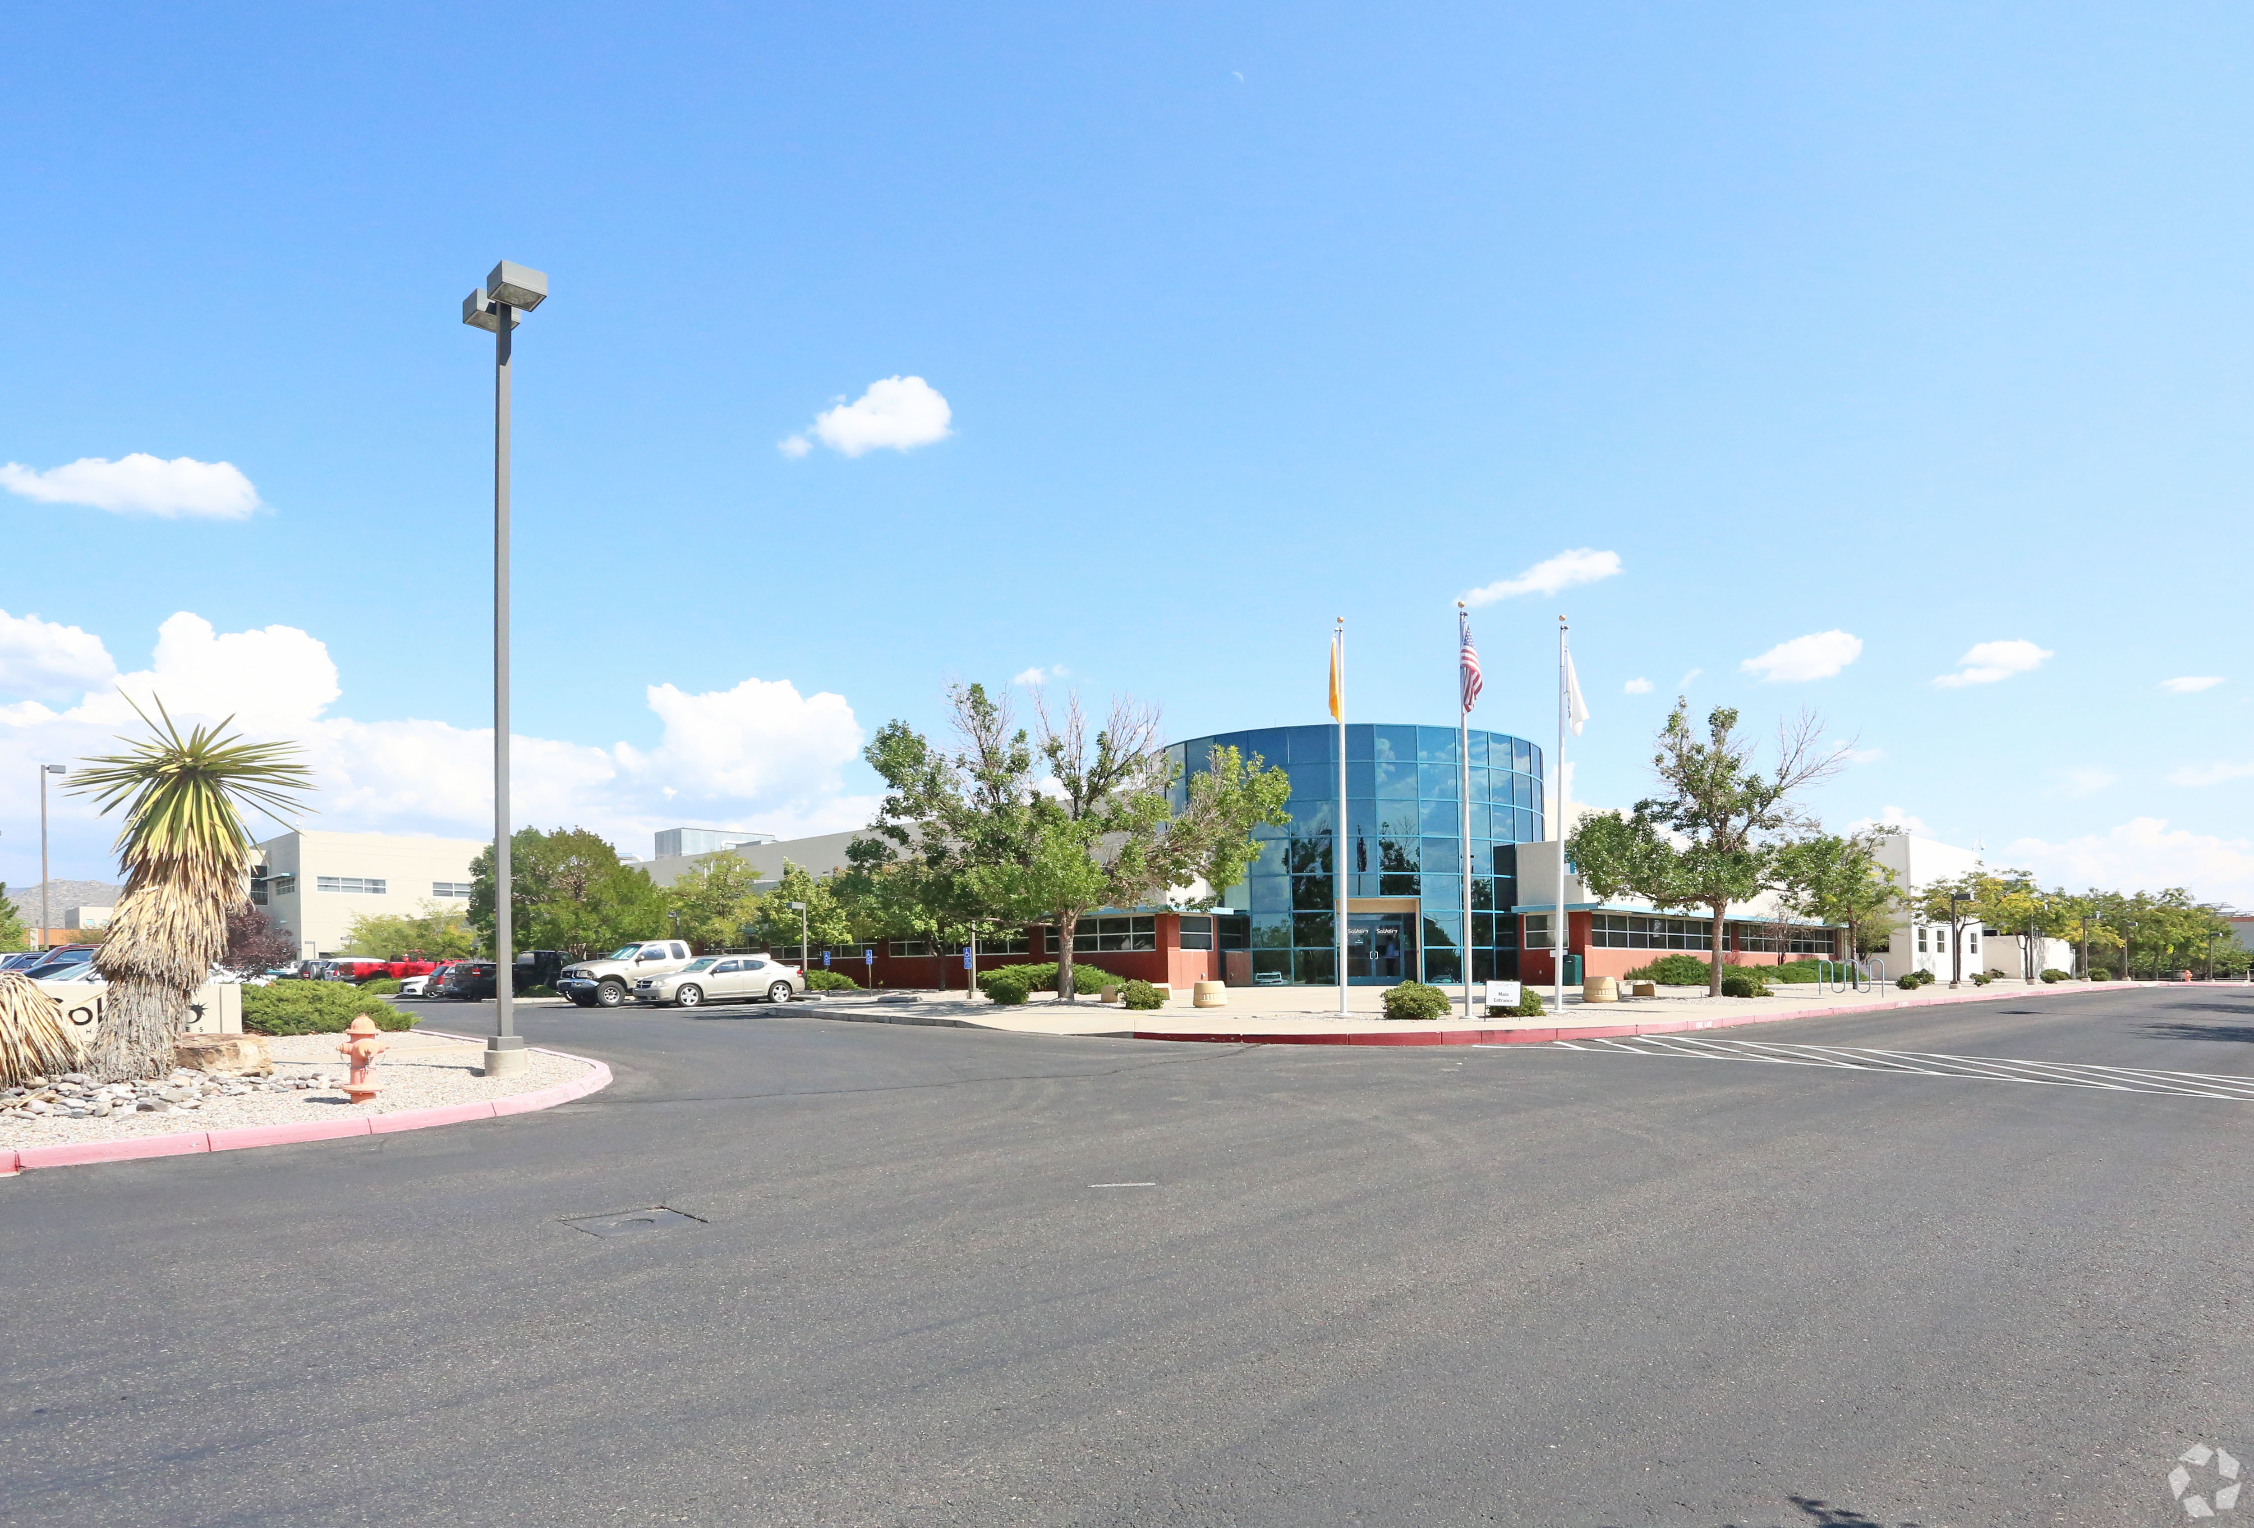
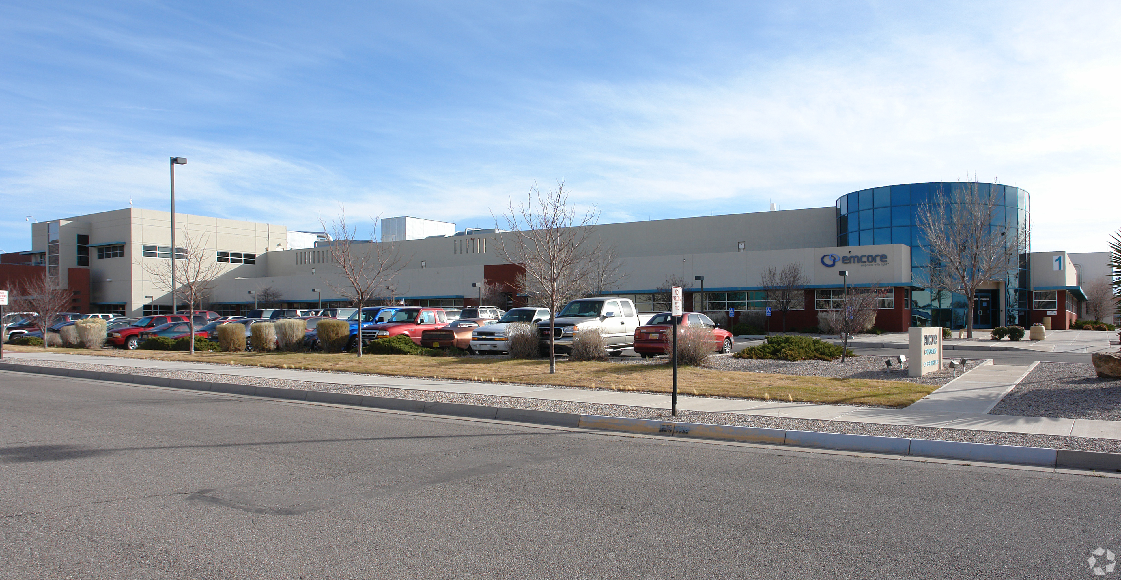
SolAero Technologies
TRANSACTION SUMMARY
THE SITUATION
Founded in 1998, SolAero Technologies Corp. is a leading provider of high efficiency solar cells, solar panels and composite structural products for satellite and aerospace applications. SolAero is a leader in the development, manufacturing and delivery of high efficiency solar cells, Coverglass Interconnected Cells (CICs) and solar panels to the aerospace industry. The products are viewed as mission‐critical as a satellite’s operational success depends on its available power and capacity to transmit data. SolAero manufactures its products in a specialized solar cell foundry enabling high‐volume, cost‐effective solar cell production.
SolAero is a privately held company that had the benefit of a recent restructuring of its debt and equity position with its largest debt holders converting debt equity. The business had a backlog of business, which would drive its growth for the foreseeable future. A sale-leaseback of this Albuquerque, NM HQ and main industrial facility would provide working capital for the business.
THE TRANSACTION
Keen aggressively marketed the opportunity to industrial investors and sale-leaseback investors. Our outreach generated significant interest and several offers. The offer that SolAero eventually moved forward with and closed on was above the offering asking price.
Sale-leaseback of
101,700 sq. ft. corporate headquarters and main industrial facility on 7.04+ Acres for $11,000,000

Slide 2
SolAero Technologies
TRANSACTION SUMMARY
THE COMPANY
Founded in 1998, SolAero Technologies Corp. is a leading provider of high efficiency solar cells, solar panels and composite structural products for satellite and aerospace applications. SolAero is a leader in the development, manufacturing and delivery of high efficiency solar cells, Coverglass Interconnected Cells (CICs) and solar panels to the aerospace industry. The products are viewed as mission‐critical as a satellite’s operational success depends on its available power and capacity to transmit data. SolAero manufactures its products in a specialized solar cell foundry enabling high‐volume, cost‐effective solar cell production.
THE SITUATION
SolAero is a privately held company that had the benefit of a recent restructuring of its debt and equity position with its largest debt holders converting debt equity. The business had a backlog of business, which would drive its growth for the foreseeable future. A sale-leaseback of this Albuquerque, NM HQ and main industrial facility would provide working capital for the business.
THE TRANSACTION
Keen aggressively marketed the opportunity to industrial investors and sale-leaseback investors. Our outreach generated significant interest and several offers. The offer that SolAero eventually moved forward with and closed on was above the offering asking price.
Sale-leaseback of
101,700 sq. ft. corporate headquarters and main industrial facility on 7.04+ Acres for $11,000,000

Slide 3
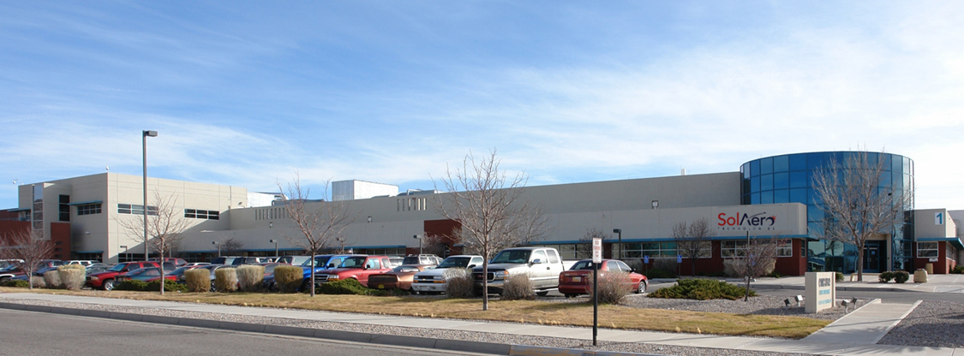
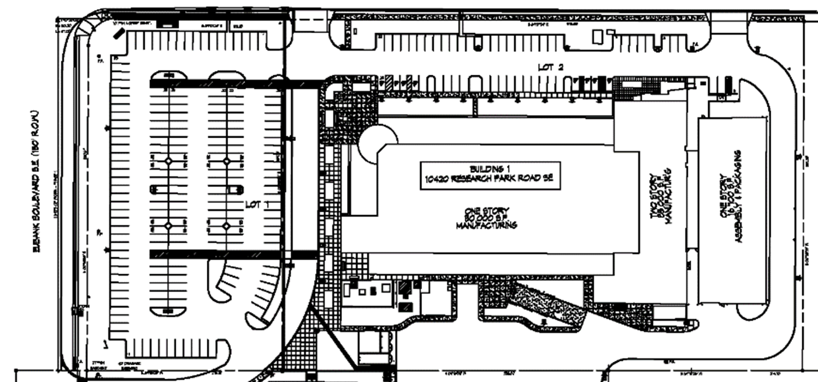
Currently Under Contract: SolAero Technologies Corporate HQ
TRANSACTION SUMMARY
SALE-LEASEBACK OPPORTUNITY
10420 Research Road SE, Albuquerque, NM
Total building area: 101,700 SF on 7.04 +/- acres
The property is approximately 84% (85,428 SF) clean room/lab space, including the 16,700 SF high-bay clean room manufacturing area added in 2006.
SolAero’s end market consists of satellite manufactures focused on commercial, national security and civil space end markets.
SolAero Technologies Corporate Headquarters is located in the internationally recognized, master-planned, and strategically located, Albuquerque’s Sandia Science & Technology Park

