Slide 1
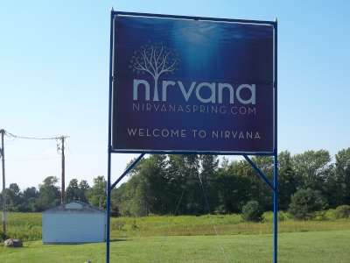
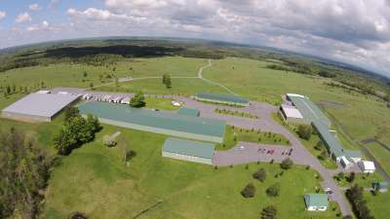
Nirvana, Inc.
TRANSACTION SUMMARY
THE COMPANY
Nirvana, Inc. and Affiliates (the “Debtors”) are manufacturers and bottlers of spring water captured from four licensed springs on over 1,600 acres of real property located in the foothills of the Adirondack Mountains at Forestport, New York.
Sold Nirvana, Inc. as a going-concern; $5,740,000
THE SITUATION
Nirvana Inc. and its affiliates filed chapter 11 in the United States Bankruptcy Court for the Northern District of New York.
THE TRANSACTION
Keen aggressively marketed Nirvana to strategic and financial buyers as well as liquidators and real estate investors. Keen conducted an auction that was well attended by parties interested in the turn-key company and buyers for groups of assets. The result was the sale of the business to a strategic buyer for $5,740,000. The sale was approved by the Bankruptcy Court.

Slide 2
Nirvana, Inc.
TRANSACTION SUMMARY
THE COMPANY
Nirvana, Inc. and Affiliates (the “Debtors”) are manufacturers and bottlers of spring water captured from four licensed springs on over 1,600 acres of real property located in the foothills of the Adirondack Mountains at Forestport, New York.
THE SITUATION
Sold Nirvana, Inc. as a going-concern; $5,740,000
Nirvana Inc. and its affiliates filed chapter 11 in the United States Bankruptcy Court for the Northern District of New York.
THE TRANSACTION
Keen aggressively marketed Nirvana to strategic and financial buyers as well as liquidators and real estate investors. Keen conducted an auction that was well attended by parties interested in the turn-key company and buyers for groups of assets. The result was the sale of the business to a strategic buyer for $5,740,000. The sale was approved by the Bankruptcy Court.
REFERENCE
Camille Hill, Esq. (Bond, Schoeneck & King Attorneys), T: (315) 218-8627, hillc@bsk.com
Jay Teitelbaum, Esq. (Teitelbaum & Baskin, LLC), (914) 437-7670, jteitelbaum@tblawllp.com

