Slide 1
The L’Ermitage Advantage
As highlighted on page 35 of this presentation, Keen was engaged by the Special Master for the US DOJ to sell the L’Ermitage Beverly Hills Hotel.
This hotel had been tied up in the 1MDB $6.5 billion international money laundering scandal. In a 35-day marketing period, Keen had:
over 1,000 inquiries
over 800 executed NDAs
over 50 written offers
Based upon this project and the 800+ executed NDAs, Keen has current contact information for virtually every real estate investor in North America and globally. Our prospect list from the L’Ermitage projected included:
hotel flags
hotel investment and management companies
private real estate equity firms
Family offices and high-net-worth individuals

Slide 2
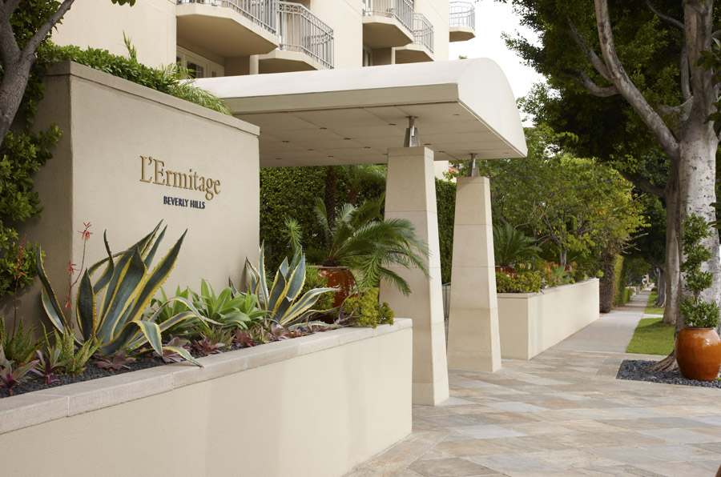
L’Ermitage Beverly Hills Hotel, Special Master
TRANSACTION SUMMARY
THE SITUATION
The United States District Court for the Central District of California, at the request of the United States Department of Justice, entered an Order authorizing the sale of the L’Ermitage Beverly Hills Hotel, a 116-suite luxury hotel, that was tied up in the multi-billion dollar 1MDB scandal.
Michael M. Eidelman, Esq., Vedder Price P.C., as Special Master, engaged Keen to broker the sale.
In May 2020, during the COVID quarantine, Keen initiated a robust marketing plan that leveraged its industry relationships and its proprietary database. Keen fielded inquiries from over 1,000 prospects, nearly 800 of whom executed the non-disclosure agreement and received over 50 offers.
Keen successfully secured a $100M offer from EOS Investors LLC. The sale closed on October 22, 2020. This sale is one of the largest hospitality transactions in 2020.
Sold L’Ermitage Beverly Hills Hotel $100,000,000 / ($862,000/key)

Slide 3
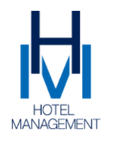
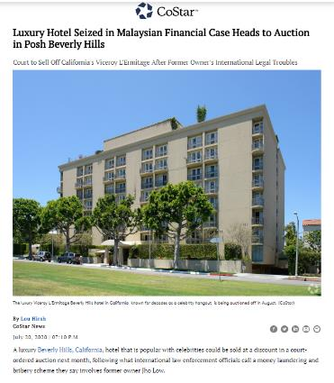
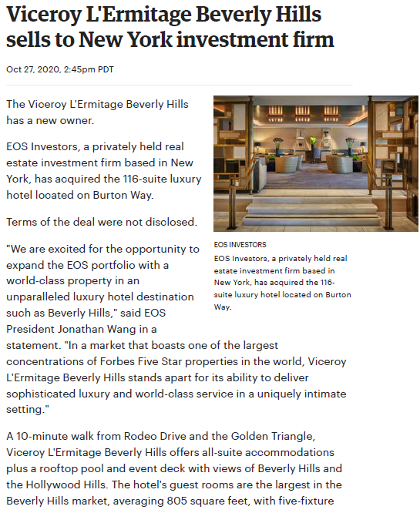
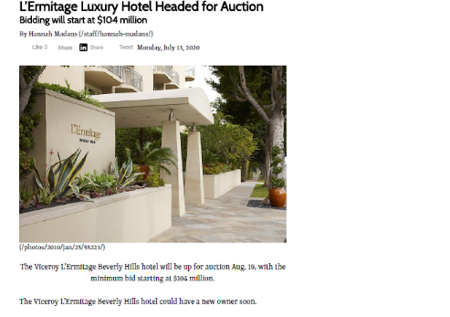
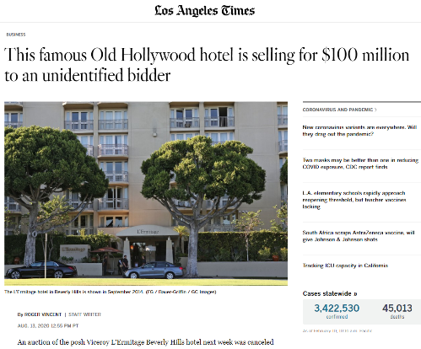
Summary of L’Ermitage Beverly Hills Market Response & Media Coverage
SUCCESS IN NUMBERS
Inquiries from over 1,000 Prospects
~800 executed the non-disclosure agreement
Over 50 offer packages; offers higher than pre-Covid values
Sale for $100,000,000 / ($862,000/key)
The 3rd highest priced hospitality transaction in 2020
with a $70-75M valuation

Slide 4
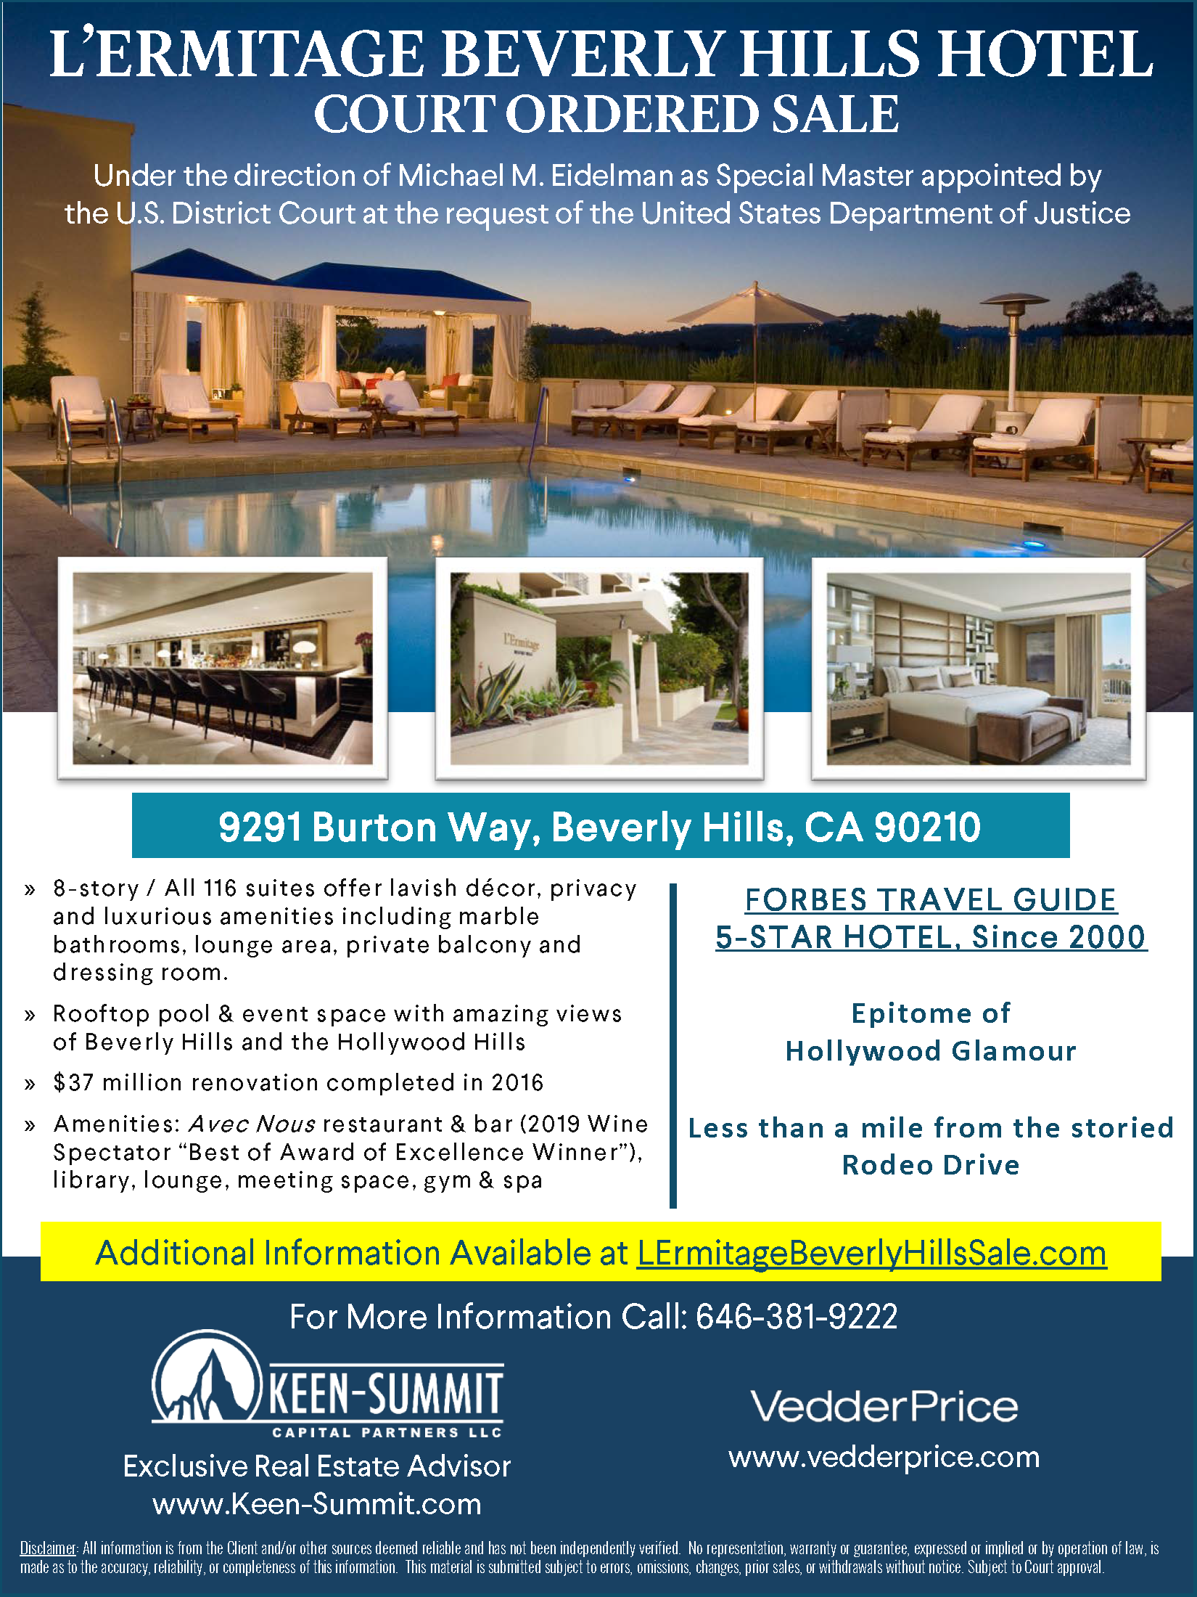

Slide 5
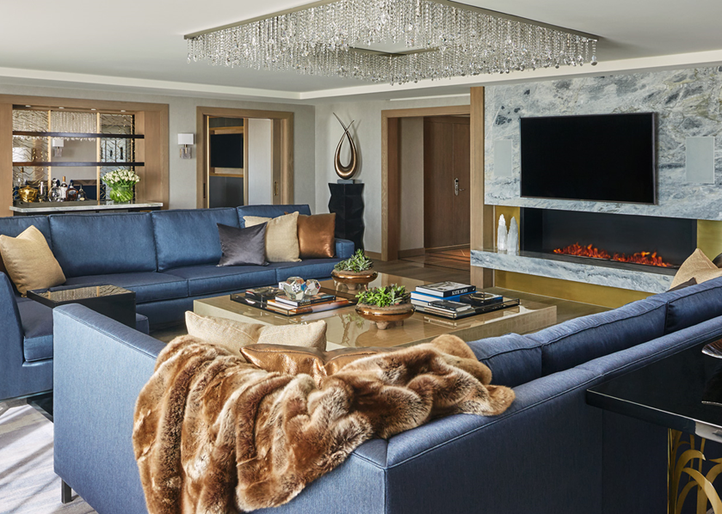
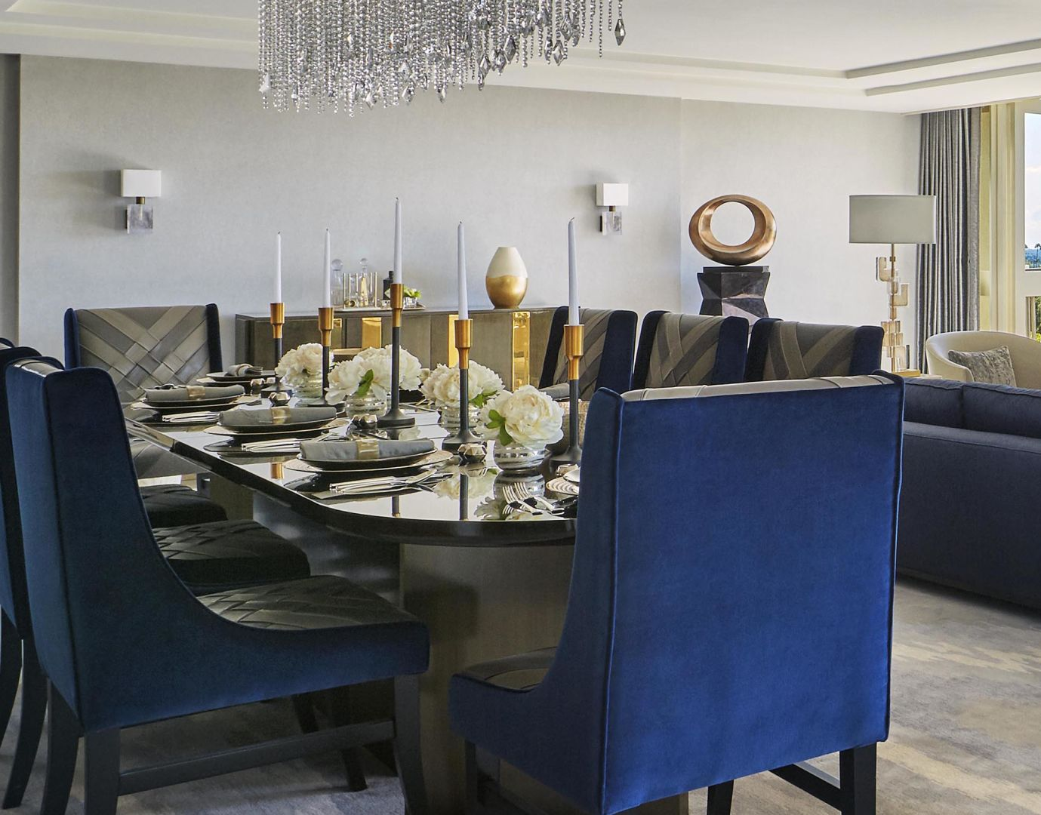
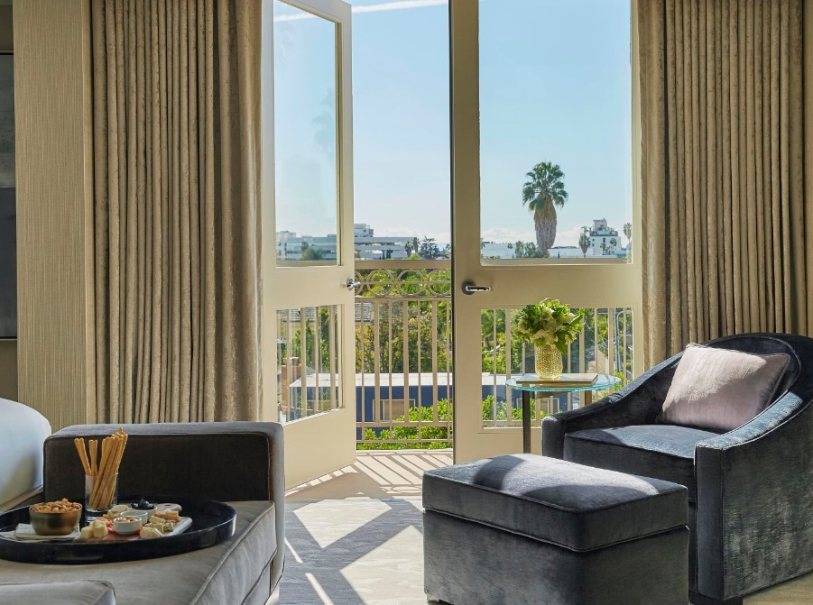
Accommodations

Slide 6
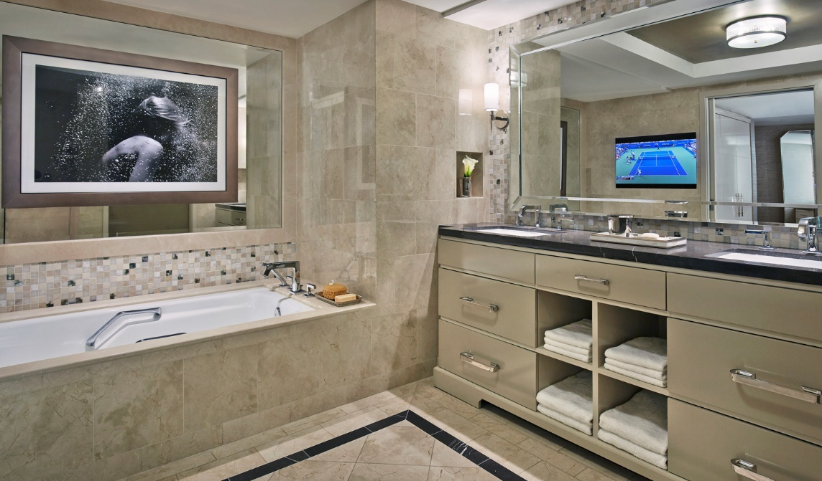
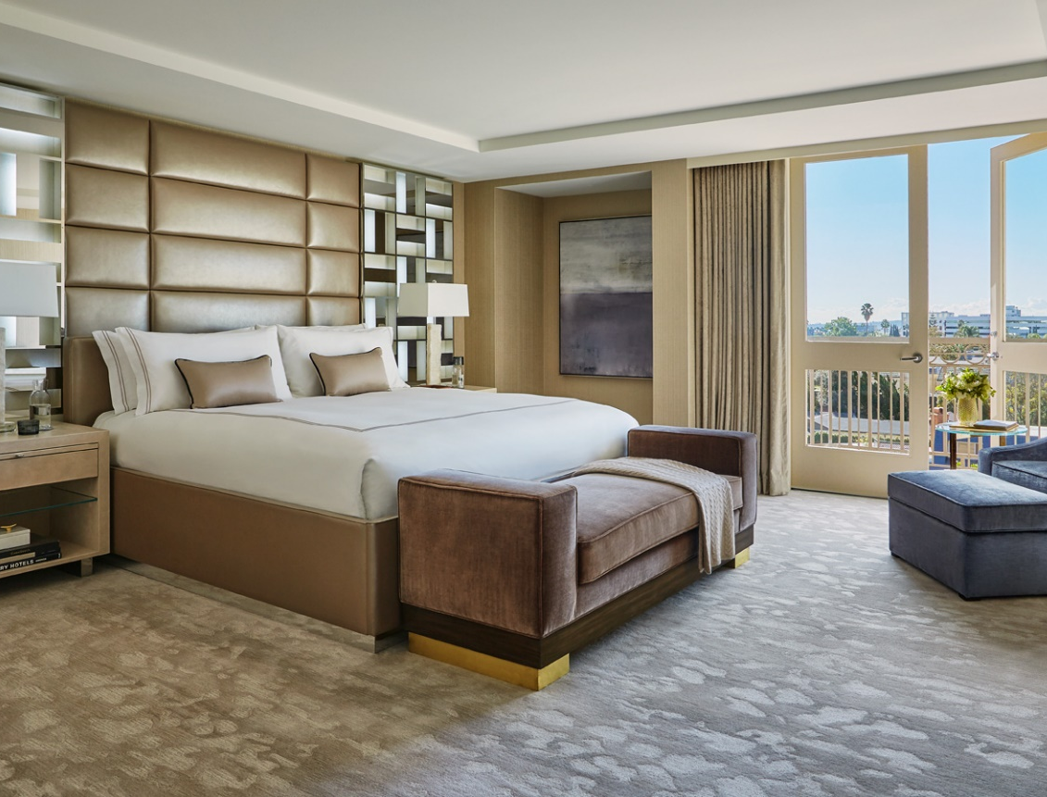
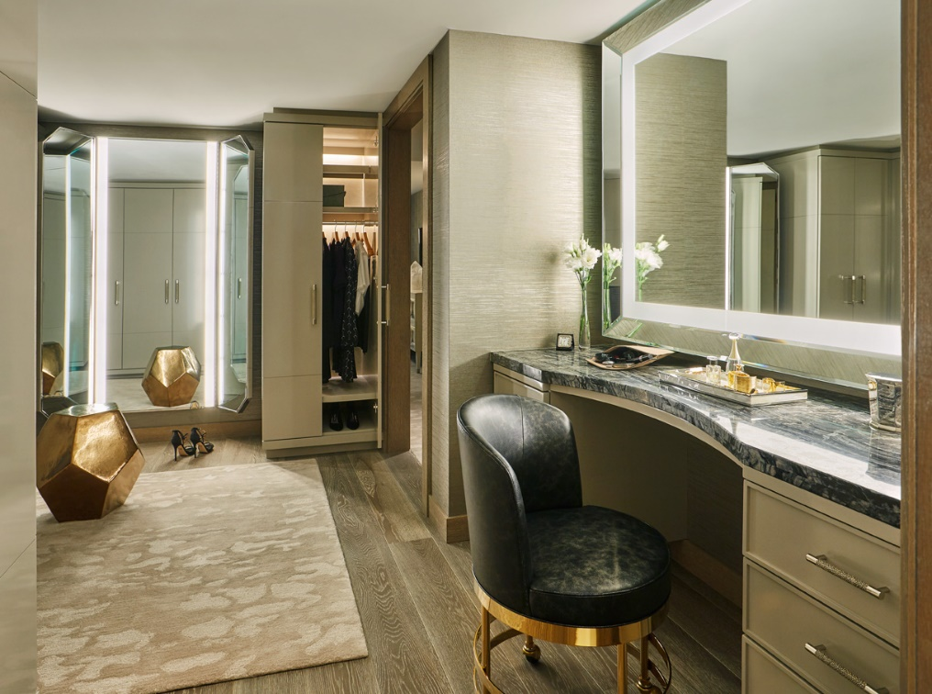
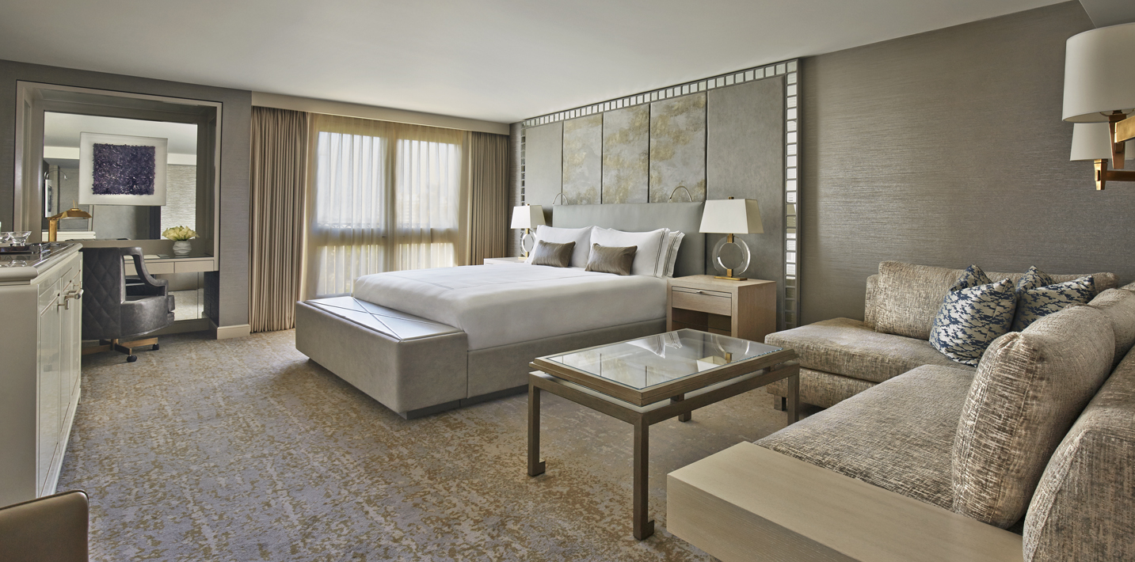
Accommodations

Slide 7
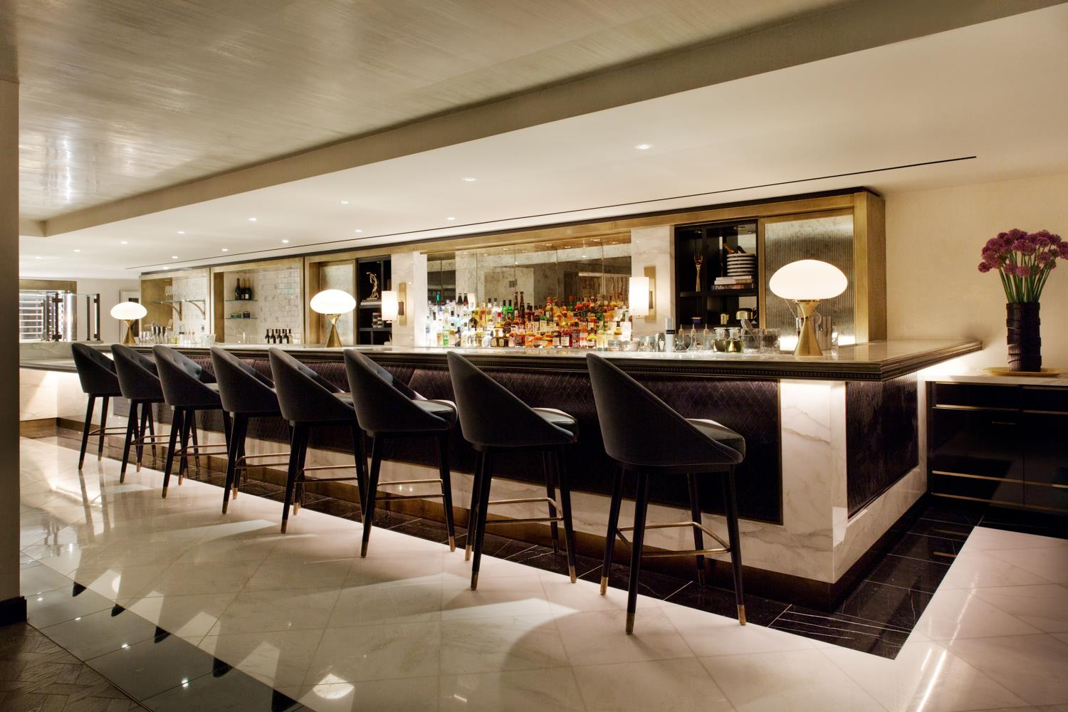
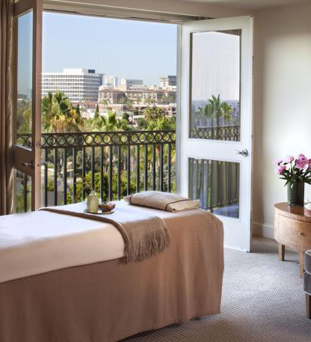
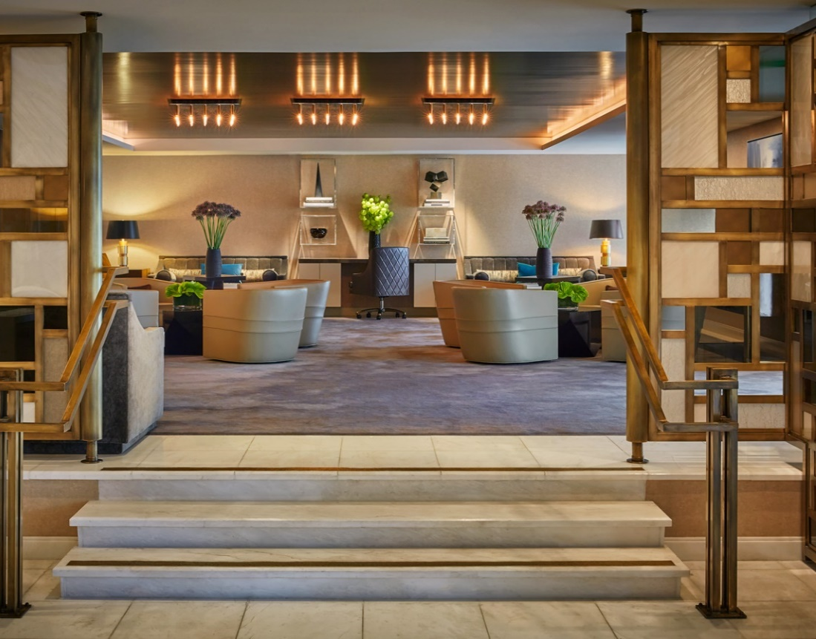
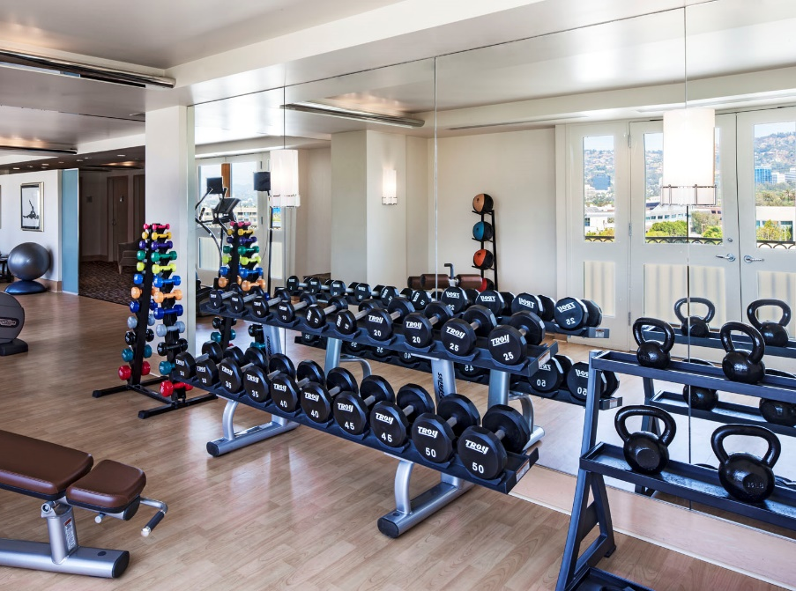
Public Space, Gym and Spa

Slide 8
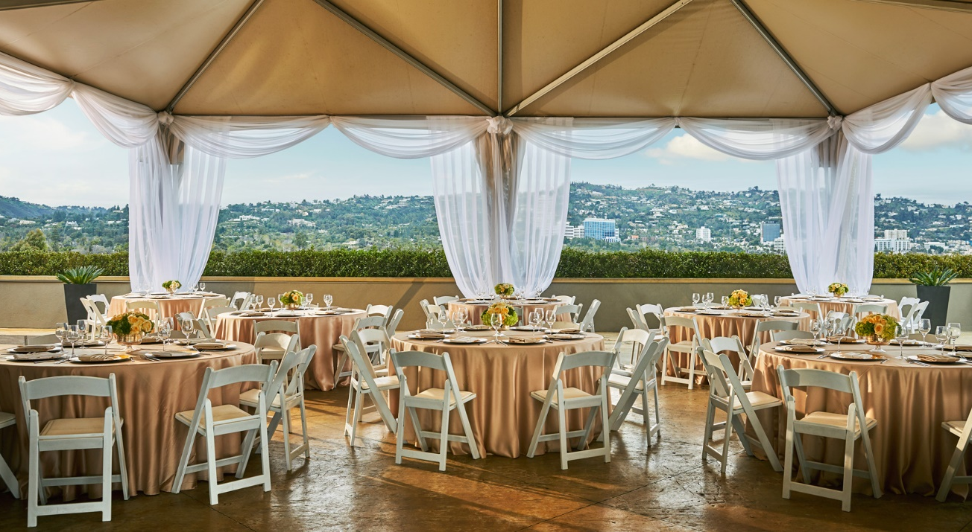
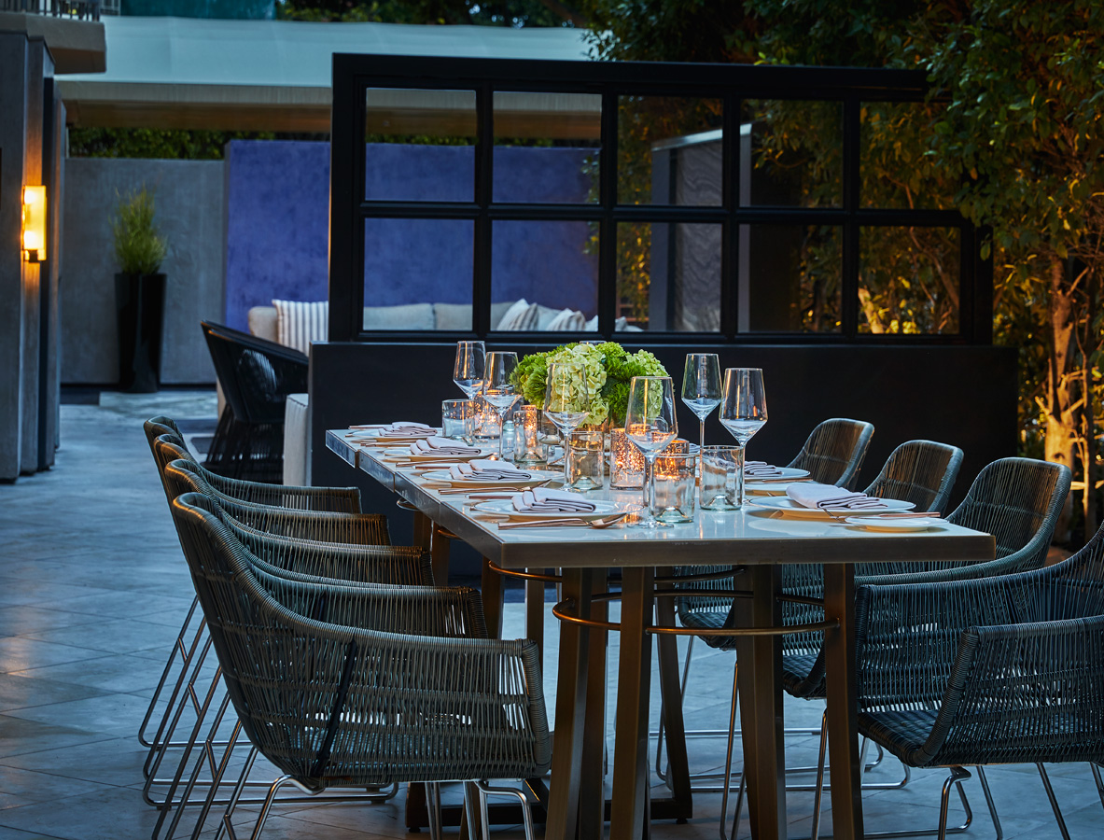
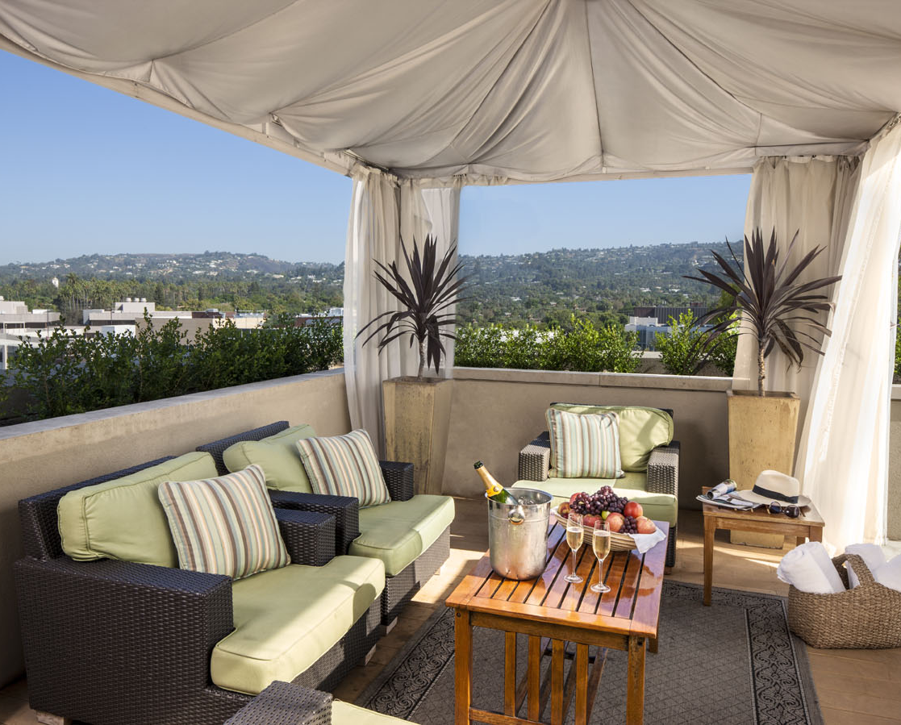
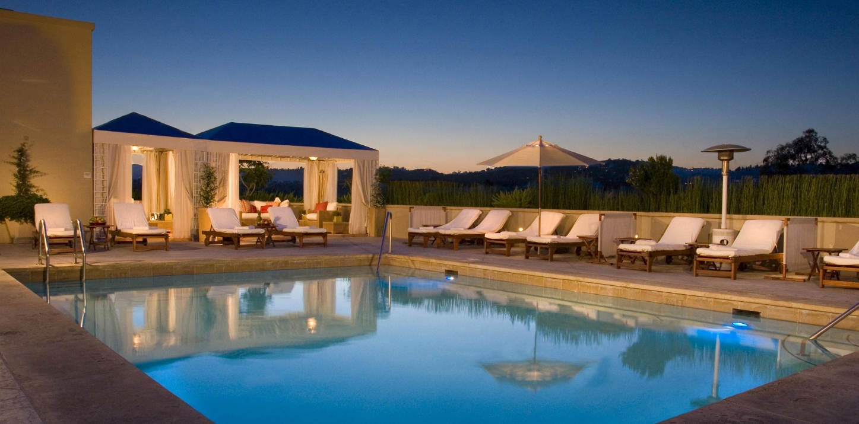
Rooftop Pool, Event Space & Restaurant

