Slide 1

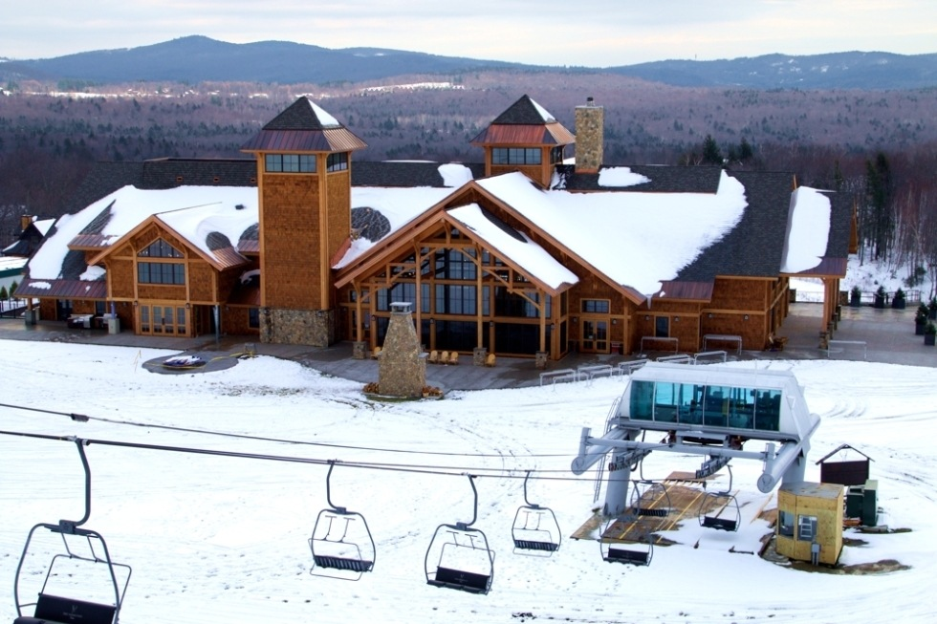
The Hermitage Club at
Haystack Ski Mountain, Debtor
TRANSACTION SUMMARY
THE COMPANY
The Hermitage Club at Haystack Ski Mountain, an 838-acre, members-only ski and golf resort in Wilmington, VT, closed in the Spring of 2018 upon the commencement of a foreclosure action. By May 2019, the debtors were in a Chapter 7 bankruptcy proceeding.
The debtors’ assets included a private ski resort at Haystack Mountain, golf course, Hermitage Inn, Snow Goose Inn, Doveberry Inn, Horizon Inn, and undeveloped parcels of land.
Sold
The Hermitage Club at Haystack Ski Mountain, golf course, hospitality portfolio and golf course
$8,060,000
THE SITUATION
On February 20, 2020, the bankruptcy trustee obtained court approval for stalking horse offers on the debtors’ assets, for a March 16 bid deadline, and for a March 20 auction
With six weeks until the bid deadline (and a growing coronavirus pandemic), Berkshire Bank, as a secured mortgagee, engaged Keen to advertise and market the bank’s collateral for the auction.
THE TRANSACTION
In the midst of the pandemic (with a telephonic Bankruptcy Court auction), Keen successfully secured an $8,060,000 overbid for the debtors’ assets. Closing in June 2020

