Slide 1

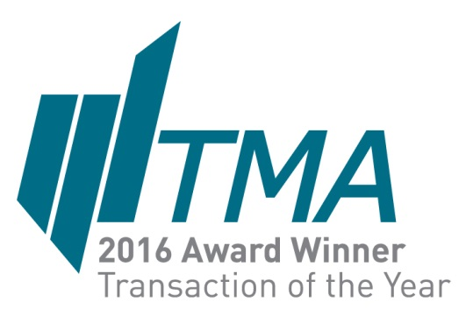
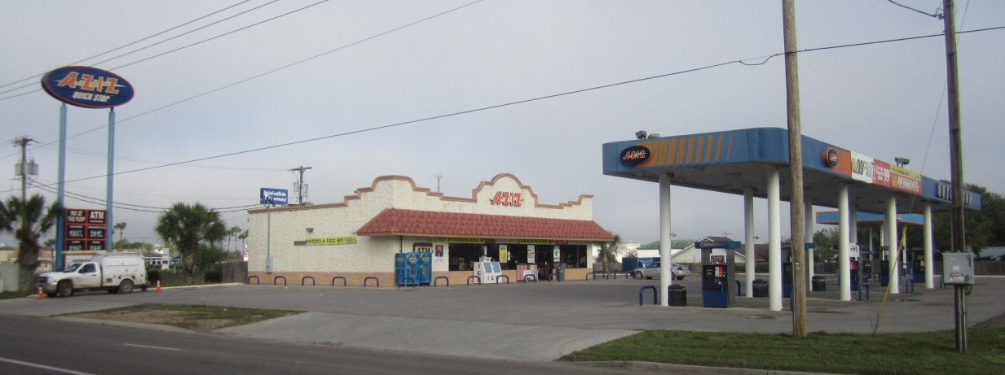
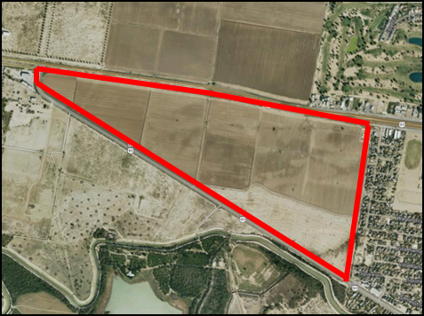
Aziz Convenience
Stores LLC, DIP
TRANSACTION SUMMARY
THE COMPANY
Aziz Convenience Stores LLC was the largest privately-owned, independently branded convenience store/gas station chain in the Southern Texas market. The chain, headquartered in McAllen, TX, operated 28 convenience stores/gas stations.
Despite having positive EBITDA, the company was unable to service its $28 million indebtedness and owed back sales taxes of $10 million. In Chapter 11, the company hired Keen to create an exit by simultaneously marketing the business and its assets for multiple alternative transaction structures including sale-leaseback of the store locations, sale of the business, joint-venture, recapitalization or refinance.
THE TRANSACTION
Keen aggressively marketed the opportunity and secured a $28,000,000+ Stalking Horse Contract with a Sunoco affiliate. Following a robust overbid auction, Sunoco won the business for $41,600,000.
Separate from the convenience store/gas station chain, Keen sold a 200-acres parcel and negotiated a private sale contract on an as-is basis with a very quick closing for $5,000,000.
Sold
28 store, c‐store/gas station chain as a Going-Concern and
200-acre parcel,
Hidalgo County, TX,
$46,600,000

Slide 2
Aziz Convenience
Stores LLC, DIP
TRANSACTION SUMMARY
THE COMPANY
Established in 1983, Aziz Convenience Stores LLC was a privately owned and operated, independently branded, chain of 28 convenience stores/gas stations, located in Southern Texas. Headquartered in McAllen, TX, the chain provides gas and classic convenience store type items. The chain was the largest independently branded convenience store/gas station chain in the market.
THE SITUATION
Despite the Company’s TTM EBITDA of $3M, they filed Chapter 11 in the US Bankruptcy Court for the Southern District of Texas. Keen was retained to create an exit for the debtor by simultaneously marketing the business and its assets for multiple alternative transaction structures including sale-leaseback of the store locations, sale of the business, joint-venture, recapitalization or refinance. In addition to the 28 convenience stores/gas stations, Aziz owned a 200-acre undeveloped and unentitled parcel of land on the outskirts of Hidalgo County.
THE TRANSACTION
Keen aggressively marketed the opportunity and secured a $28,000,000+ Stalking Horse Contract with Susser Petroleum Property Company LLC d/b/a Sunoco. Keen then marketed the Stalking Horse Contract for overbid and, at an auction with active bidding, Susser secured the business for $41,600,000.
Separate from the convenience store/gas station chain, Keen aggressively marketed and identified a buyer for the 200-acres parcel and negotiated a private sale contract on an as-is basis with a very quick closing for $5,000,000.
Sold
28 store, c‐store/
gas station chain as a
Going-Concern and
200-acre parcel,
Hidalgo County, Texas,
$46,600,000

Slide 3
Aziz Convenience
Stores LLC, DIP
TRANSACTION SUMMARY
THE COMPANY
Established in 1983, Aziz Convenience Stores LLC was a privately owned and operated, independently branded, chain of 28 convenience stores/gas stations, located in Southern Texas. Headquartered in McAllen, TX, the chain provides gas and classic convenience store type items. The chain was the largest independently branded convenience store/gas station chain in the market.
THE SITUATION
Despite the Company’s TTM EBITDA of $3M, they filed Chapter 11 in the US Bankruptcy Court for the Southern District of Texas. Keen was retained to create an exit for the debtor by simultaneously marketing the business and its assets for multiple alternative transaction structures including sale-leaseback of the store locations, sale of the business, joint-venture, recapitalization or refinance. In addition to the 28 convenience stores/gas stations, Aziz owned a 200-acre undeveloped and unentitled parcel of land on the outskirts of Hidalgo County.
THE TRANSACTION
Keen aggressively marketed the opportunity and secured a $28,000,000+ Stalking Horse Contract with Susser Petroleum Property Company LLC d/b/a Sunoco. Keen then marketed the Stalking Horse Contract for overbid and, at an auction with active bidding, Susser secured the business for $41,600,000.
Separate from the convenience store/gas station chain, Keen aggressively marketed and identified a buyer for the 200-acres parcel and negotiated a private sale contract on an as-is basis with a very quick closing for $5,000,000.
Sold
28 store, c‐store/
gas station chain as a
Going-Concern and
200-acre parcel,
Hidalgo County, Texas,
$46,600,000
REFERENCES
  Douglas J. Brickley (Jefferies LLC): (281) 774-2086 or dbrickley@Jefferies.com
  Matthew S. Okin, Esq. (Okin & Adams LLP): (713) 228-4101 or mokin@okinadams.com

Slide 4
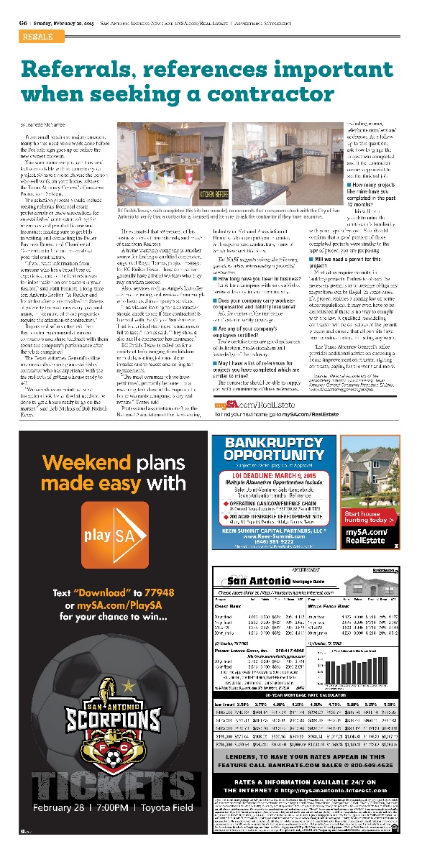
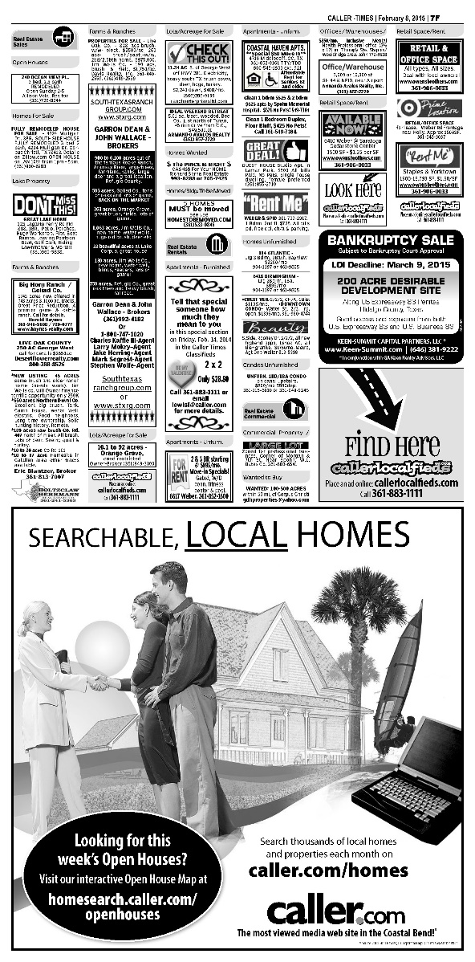

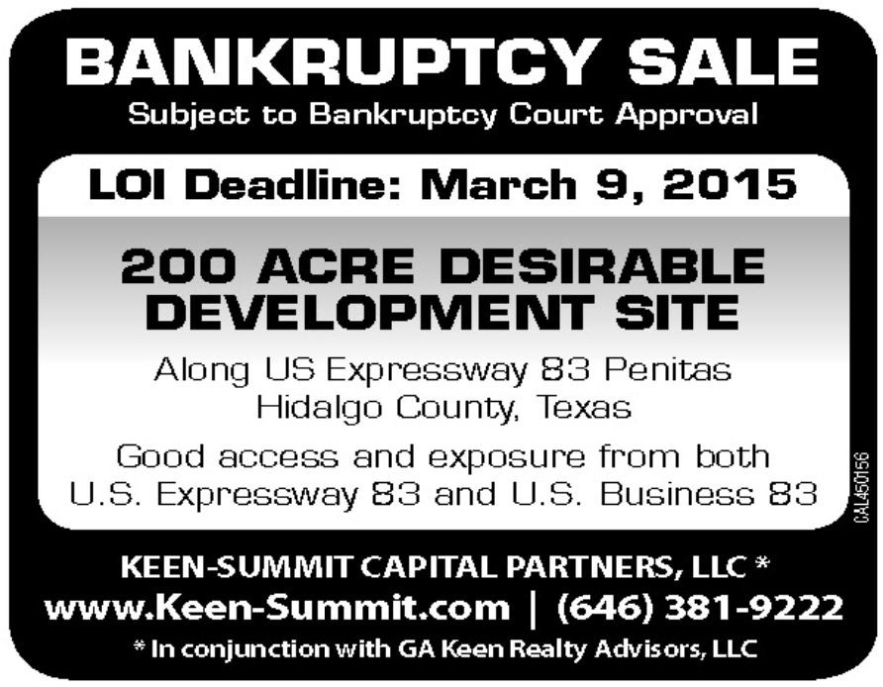
Aziz – 200 Acre Parcel of Land
Advertisement Examples

Slide 5
Aziz Convenience Stores, DIP
Marketing Plan

